Slide 1
Motivation
Not all problems can be converted into one with fixed-length inputs and outputs
Problems such as Speech Recognition or Time-series Prediction require a system to store and use context information
Simple case: Output YES if the number of 1s is even, else NO 1000010101 – YES, 100011 – NO, …
Hard/Impossible to choose a fixed context window
There can always be a new sample longer than anything seen

Slide 2
Recurrent Neural Networks (RNNs)
Recurrent Neural Networks take the previous output or hidden states as inputs. The composite input at time t has some historical information about the happenings at time T < t
RNNs are useful as their intermediate values (state) can store information about past inputs for a time that is not fixed a priori

Slide 3
Sample Feed-forward Network
y₁
h₁
x₁
t = 1

Slide 4
Sample RNN
y₃
y₂
h₃
y₁
h₂
x₃
h₁
t = 3
x₂
x₁
t = 2
t = 1

Slide 5
Sample RNN
y₃
y₂
h₃
y₁
h₂
x₃
h₁
t = 3
x₂
h₀
t = 2
x₁
t = 1

Slide 6
The Vanilla RNN Cell
x_{t}
h_{t-1}
W
h_{t}

Slide 7
The Vanilla RNN Forward
C₁
C₂
C₃
y₁
y₂
y₃
x₁ h₀
x₂ h₁
h₁
x₃ h₂
h₂
h₃

Slide 8
The Vanilla RNN Forward
C₁
C₂
C₃
y₁
y₂
y₃
x₁ h₀
x₂ h₁
h₁
x₃ h₂
h₂
h₃
indicates shared weights

Slide 9
Recurrent Neural Networks (RNNs)
Note that the weights are shared over time
Essentially, copies of the RNN cell are made over time (unrolling/unfolding), with different inputs at different time steps

Slide 15
Sentiment Classification
Classify a restaurant review from Yelp! OR movie review from IMDB OR … as positive or negative
Inputs: Multiple words, one or more sentences
Outputs: Positive / Negative classification
“The food was really good”
“The chicken crossed the road because it was uncooked”

Slide 16
Sentiment Classification
RNN
h₁
The

Slide 17
Sentiment Classification
RNN
RNN
h₁
h₂
The
food

Slide 18
Sentiment Classification
h_{n}
RNN
RNN
RNN
h₁
h₂
h_{n-1}
The
food
good

Slide 19


Sentiment Classification
Linear Classifier
h_{n}
RNN
RNN
RNN
h₁
h₂
h_{n-1}
The
food
good

Slide 20
Sentiment Classification
Ignore
Ignore
Linear Classifier
h₁
h₂
h_{n}
RNN
RNN
RNN
h₁
h₂
h_{n-1}
The
food
good

Slide 21
Sentiment Classification
h = Sum(…)
h₁
h_{n}
h₂
RNN
RNN
RNN
h₁
h₂
h_{n-1}
The
food
good
http://deeplearning.net/tutorial/lstm.html

Slide 22
Sentiment Classification
Linear Classifier
h = Sum(…)
h₁
h_{n}
h₂
RNN
RNN
RNN
h₁
h₂
h_{n-1}
The
food
good
http://deeplearning.net/tutorial/lstm.html

Slide 23
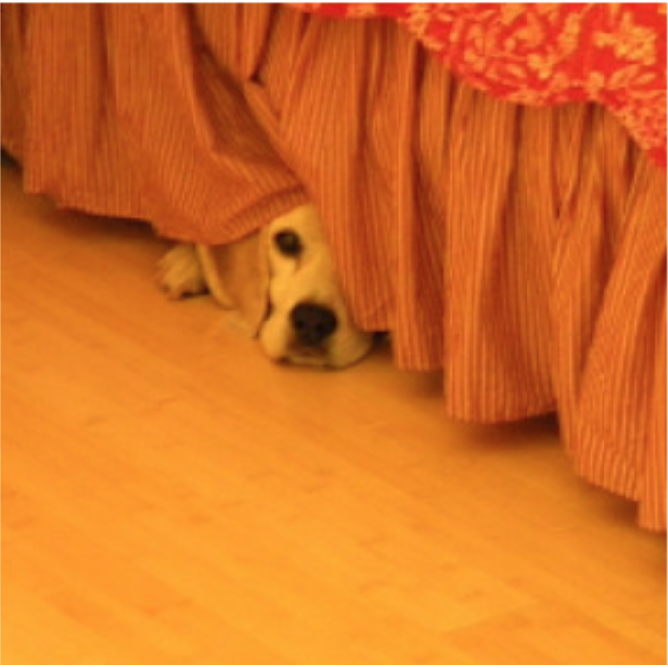
Image Captioning
Given an image, produce a sentence describing its contents
Inputs: Image feature (from a CNN)
Outputs: Multiple words (let’s consider one sentence)
: The dog is hiding

Slide 24
Image Captioning
RNN
CNN

Slide 25
Image Captioning
The
Linear Classifier
h₂
RNN
RNN
h₁
h₂
CNN

Slide 26
Image Captioning
The
dog
Linear Classifier
Linear Classifier
h₂
h₃
RNN
RNN
RNN
h₁
h₂
h₃
CNN

Slide 27
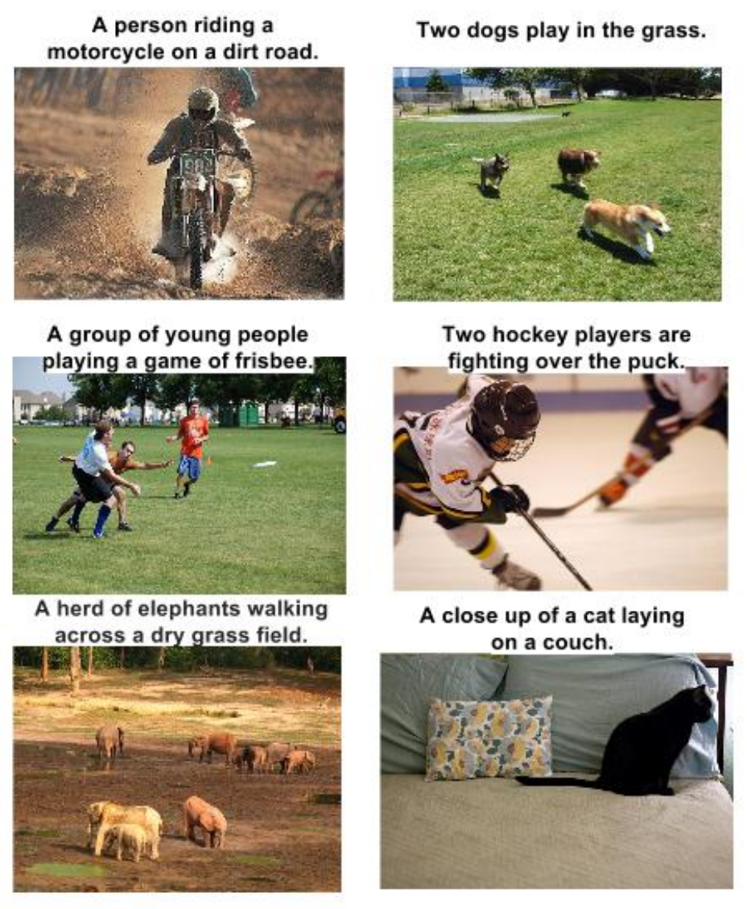
RNN Outputs: Image Captions
Show and Tell: A Neural Image Caption Generator, CVPR 15

Slide 28
RNN Outputs: Language Modeling
VIOLA:
Why, Salisbury must find his flesh and thought
That which I am not aps, not a man and in fire,
To show the reining of the raven and the wars
To grace my hand reproach within, and not a fair are hand,
That Caesar and my goodly father's world;
When I was heaven of presence and our fleets,
We spare with hours, but cut thy council I am great,
Murdered and by thy master's ready there
My power to give thee but so much as hell:
Some service in the noble bondman here,
Would show him to her wine.
KING LEAR:
O, if you were a feeble sight, the courtesy of your law,
Your sight and several breath, will wear the gods
With his heads, and my hands are wonder'd at the deeds,
So drop upon your lordship's head, and your opinion
Shall be against your honour.
http://karpathy.github.io/2015/05/21/rnn-effectiveness/

Slide 29
Input – Output Scenarios
Single - Single
Feed-forward Network
Single - Multiple
Image Captioning
Multiple - Single
Sentiment Classification
Multiple - Multiple
Translation
Image Captioning

Slide 30
Input – Output Scenarios
Note: We might deliberately choose to frame our problem as a
particular input-output scenario for ease of training or
better performance.
For example, at each time step, provide previous word as
input for image captioning
(Single-Multiple to Multiple-Multiple).

Slide 31
The Vanilla RNN Forward
C₁
C₂
C₃
y₁
y₂
y₃
x₁ h₀
x₂ h₁
h₁
x₃ h₂
h₂
“Unfold” network through time by making copies at each time-step
h₃

Slide 32
BackPropagation Refresher
C
y
f(x; W)
x

Slide 33
Multiple Layers
C
y₂
f₂(y₁; W₂)
y₁
f₁(x; W₁)
x

Slide 34
Chain Rule for Gradient Computation
C
y₂
f₂(y₁; W₂)
y₁
f₁(x; W₁)
x
Application of the Chain Rule

Slide 35
Chain Rule for Gradient Computation
Given:
We are interested in computing:
y
Intrinsic to the layer are:
f(x; W)
x

Slide 36
Chain Rule for Gradient Computation
Given:
We are interested in computing:
Intrinsic to the layer are:
f(x; W)
Equations for common layers: http://arunmallya.github.io/writeups/nn/backprop.html

Slide 37
Extension to Computational Graphs
y₁
y₂
y
f₁(y; W₁)
f₂(y; W₂)
f(x; W)
y
y
x
f(x; W)
x

Slide 38
Extension to Computational Graphs
f₁(y; W₁)
f₂(y; W₂)
f(x; W)
f(x; W)

Slide 39
Extension to Computational Graphs
f₁(y; W₁)
f₂(y; W₂)
f(x; W)
Gradient Accumulation
f(x; W)

Slide 40
BackPropagation Through Time (BPTT)
One of the methods used to train RNNs
The unfolded network (used during forward pass) is treated as one big feed-forward network
This unfolded network accepts the whole time series as input
The weight updates are computed for each copy in the unfolded network, then summed (or averaged) and then applied to the RNN weights

Slide 41
The Unfolded Vanilla RNN
C₁
C₂
C₃
y₁
y₂
y₃
Treat the unfolded network as one big feed-forward network!
This big network takes in entire sequence as an input
Compute gradients through the usual backpropagation
Update shared weights
h₁
h₃
h₂
h₂
h₁
h₀
x₁
x₂
x₃

Slide 42
The Unfolded Vanilla RNN Forward
C₁
C₂
C₃
y₁
y₂
y₃
x₁ h₀
x₂ h₁
h₁
x₃ h₂
h₂
h₃

Slide 43
The Unfolded Vanilla RNN Backward
C₁
C₂
C₃
y₁
y₂
y₃
x₁ h₀
x₂ h₁
h₁
x₃ h₂
h₂
h₃
Notes:
refresher for backprop before this

Slide 44
The Vanilla RNN Backward
C₁
C₂
C₃
y₁
y₂
y₃
x₁ h₀
x₂ h₁
h₁
x₃ h₂
h₂
h₃
Notes:
refresher for backprop before this

Slide 45
Issues with the Vanilla RNNs
In the same way a product of k real numbers can shrink to zero or explode to infinity, so can a product of matrices
It is sufficient for , where is the largest singular value of W, for the vanishing gradients problem to occur and it is necessary for exploding gradients that , where for the tanh non-linearity and for the sigmoid non-linearity ¹
Exploding gradients are often controlled with gradient element-wise or norm clipping
¹ On the difficulty of training recurrent neural networks, Pascanu et al., 2013

Slide 46
The Identity Relationship
Recall
Suppose that instead of a matrix multiplication, we had an identity relationship between the hidden states
The gradient does not decay as the error is propagated all the way back aka “Constant Error Flow”

Slide 47
The Identity Relationship
Recall
Suppose that instead of a matrix multiplication, we had an identity relationship between the hidden states
The gradient does not decay as the error is propagated all the way back aka “Constant Error Flow”

Slide 48
Disclaimer
The explanations in the previous few slides are handwavy
For rigorous proofs and derivations, please refer to On the difficulty of training recurrent neural networks, Pascanu et al., 2013 Long Short-Term Memory, Hochreiter et al., 1997 And other sources

Slide 49
Multi-layer RNNs
We can of course design RNNs with multiple hidden layers
y₁
y₂
y₃
y₄
y₅
y₆
x₁
x₂
x₃
x₄
x₅
x₆
Think exotic: Skip connections across layers, across time, …

Slide 50
Bi-directional RNNs
RNNs can process the input sequence in forward and in the reverse direction
y₁
y₂
y₃
y₄
y₅
y₆
x₁
x₂
x₃
x₄
x₅
x₆
Popular in speech recognition

Slide 51
Recap
RNNs allow for processing of variable length inputs and outputs by maintaining state information across time steps
Various Input-Output scenarios are possible (Single/Multiple)
RNNs can be stacked, or bi-directional
Vanilla RNNs are improved upon by LSTMs which address the vanishing gradient problem through the CEC
Exploding gradients are handled by gradient clipping

Slide 52
The Popular LSTM Cell
x_{t} h_{t-1}
x_{t} h_{t-1}
W_{i}
W_{o}
Input Gate
i_{t}
Output Gate
o_{t}
Similarly for i_{t}, o_{t}
x_{t}
h_{t-1}
W
Cell
c_{t-1}
h_{t}
f_{t}
Forget Gate
W_{f}
x_{t} h_{t-1}
* Dashed line indicates time-lag

Slide 53
Extension I: Peephole LSTM
x_{t} h_{t-1}
x_{t} h_{t-1}
W_{i}
W_{o}
Input Gate
i_{t}
Output Gate
o_{t}
Similarly for i_{t}, o_{t} (uses c_{t})
x_{t}
h_{t-1}
W
Cell
c_{t-1}
h_{t}
f_{t}
Forget Gate
W_{f}
x_{t} h_{t-1}
* Dashed line indicates time-lag

Slide 54
Peephole LSTM
Gates can only see the output from the previous time step, which is close to 0 if the output gate is closed. However, these gates control the CEC cell.
Helped the LSTM learn better timing for the problems tested – Spike timing and Counting spike time delays
Recurrent nets that time and count, Gers et al., 2000

Slide 55
Other minor variants
Coupled Input and Forget Gate
Full Gate Recurrence

Slide 56
LSTM: A Search Space Odyssey
Tested the following variants, using Peephole LSTM as standard:
No Input Gate (NIG)
No Forget Gate (NFG)
No Output Gate (NOG)
No Input Activation Function (NIAF)
No Output Activation Function (NOAF)
No Peepholes (NP)
Coupled Input and Forget Gate (CIFG)
Full Gate Recurrence (FGR)
On the tasks of:
Timit Speech Recognition: Audio frame to 1 of 61 phonemes
IAM Online Handwriting Recognition: Sketch to characters
JSB Chorales: Next-step music frame prediction
LSTM: A Search Space Odyssey, Greff et al., 2015

Slide 57
LSTM: A Search Space Odyssey
The standard LSTM performed reasonably well on multiple datasets and none of the modifications significantly improved the performance
Coupling gates and removing peephole connections simplified the LSTM without hurting performance much
The forget gate and output activation are crucial
Found interaction between learning rate and network size to be minimal – indicates calibration can be done using a small network first
LSTM: A Search Space Odyssey, Greff et al., 2015
Notes:
what tasks

Slide 58
Gated Recurrent Unit (GRU)
A very simplified version of the LSTM
Merges forget and input gate into a single ‘update’ gate
Merges cell and hidden state
Has fewer parameters than an LSTM and has been shown to outperform LSTM on some tasks
Learning Phrase Representations using RNN Encoder-Decoder for Statistical Machine Translation, Cho et al., 2014

Slide 59
GRU
x_{t} h_{t-1}
W_{z}
Update Gate
z_{t}
x_{t}
W
h’_{t}
h_{t}
h_{t-1}
r_{t}
Reset Gate
W_{f}
x_{t} h_{t-1}

Slide 60
GRU
r_{t}
Reset Gate
W_{f}
x_{t} h_{t-1}

Slide 61
GRU
x_{t}
W
h’_{t}
h_{t-1}
r_{t}
Reset Gate
W_{f}
x_{t} h_{t-1}

Slide 62
GRU
x_{t} h_{t-1}
W_{z}
Update Gate
z_{t}
x_{t}
W
h’_{t}
h_{t-1}
r_{t}
Reset Gate
W_{f}
x_{t} h_{t-1}

Slide 63
GRU
x_{t} h_{t-1}
W_{z}
Update Gate
z_{t}
x_{t}
W
h’_{t}
h_{t}
h_{t-1}
r_{t}
Reset Gate
W_{f}
x_{t} h_{t-1}

Slide 64
LSTM initialized with large positive forget gate bias?
Recall
Gradients will vanish if f is close to 0. Using a large positive bias ensures that f has values close to 1, especially when training begins
Helps learn long-range dependencies
Originally stated in Learning to forget: Continual prediction with LSTM, Gers et al., 2000, but forgotten over time
An Empirical Exploration of Recurrent Network Architectures, Jozefowicz et al., 2015

Slide 65
Summary
LSTMs can be modified with Peephole Connections, Full Gate Recurrence, etc. based on the specific task at hand
Architectures like the GRU have fewer parameters than the LSTM and might perform better
An LSTM with large positive forget gate bias works best!

Slide 66
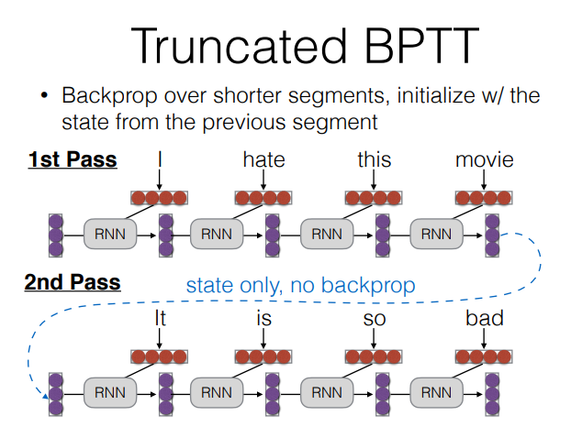

Slide 67
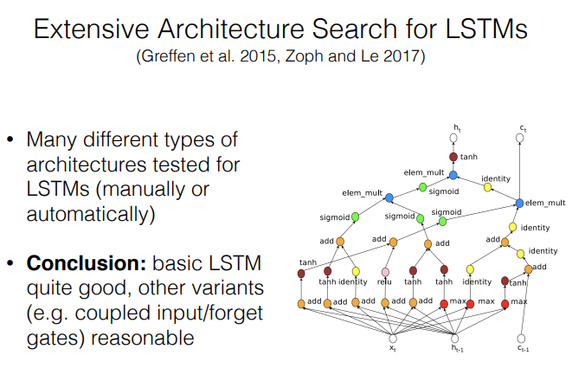

Slide 68
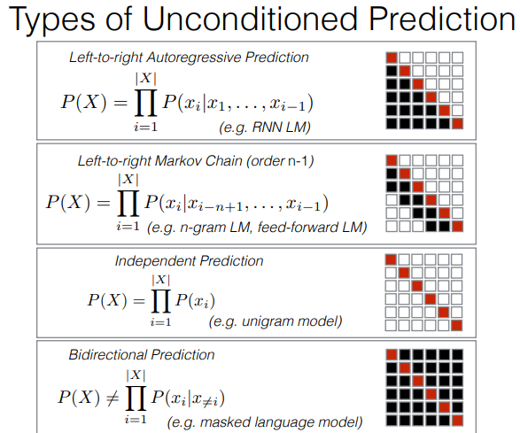

Slide 69
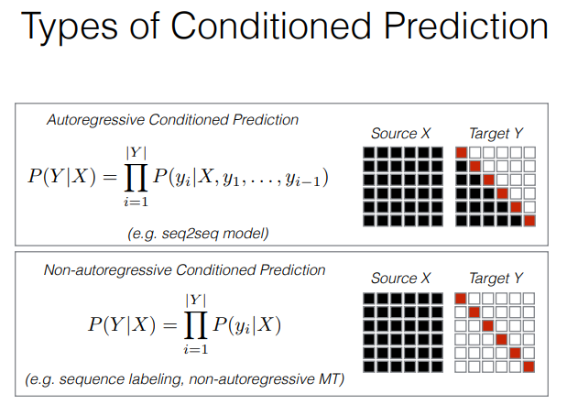

Slide 70
LSTM – Forward/Backward
Go To: Illustrated LSTM Forward and Backward Pass

Slide 71
Other Useful Resources / References
http://cs231n.stanford.edu/slides/winter1516_lecture10.pdf
http://www.cs.toronto.edu/~rgrosse/csc321/lec10.pdf
R. Pascanu, T. Mikolov, and Y. Bengio, On the difficulty of training recurrent neural networks, ICML 2013
S. Hochreiter, and J. Schmidhuber, Long short-term memory, Neural computation, 1997 9(8), pp.1735-1780
F.A. Gers, and J. Schmidhuber, Recurrent nets that time and count, IJCNN 2000
K. Greff , R.K. Srivastava, J. Koutník, B.R. Steunebrink, and J. Schmidhuber, LSTM: A search space odyssey, IEEE transactions on neural networks and learning systems, 2016
K. Cho, B. Van Merrienboer, C. Gulcehre, D. Bahdanau, F. Bougares, H. Schwenk, and Y. Bengio, Learning phrase representations using RNN encoder-decoder for statistical machine translation, ACL 2014
R. Jozefowicz, W. Zaremba, and I. Sutskever, An empirical exploration of recurrent network architectures, JMLR 2015

